Slide 1

License Attribution / Use
This work is licensed under a [Creative Commons Attribution 4.0 International License][cc-by].
Use or Adaption of this work requires attribution to the FinOps Foundation under the ccby4.0 license.
You are free to:
Share — copy and redistribute the material in any medium or format
Adapt — remix, transform, and build upon the material for any purpose, even commercially.
Under the following terms:
Attribution — You must give appropriate credit, provide a link to the license, and indicate if changes were made.
More details can be found at https://www.finops.org/introduction/how-to-use/

Slide 2
Advancing the people who manage the value of cloud
FinOps.org

Slide 3



Cloud is critical to every business but is a fundamentally different consumption model...
Decentralized
Variable
Scalable
Engineers siloed from Finance (and Procurement) are empowered to commit the company to spend
Variable cloud spend replacing data center/fixed cost spend
Instant access to resources enables innovation but often results in overprovisioning
Notes:
Cloud is critical to success by bringing The new cloud economy has us facing some new realities in the IT world:
Traditional procurement silos have broken down, buying is decentralized, and it’s only getting more so
Cloud adoption, once the purview of CTOs and the location of science-fair projects now represents MATERIAL and substantial costs for many companies, and it’s only growing
What you buy in the cloud is variable, it changes month to month, day to day, minute to minute. It’s not predictable, and it’s hard to forecast well using traditional methods. And with over 1M Cloud SKUs out there, it’s only getting more complex.
In a cloud world of vast supply, plentiful options and few constraints on your spending, inefficiency is inevitable. But all businesses must focus on efficiency, and need the information to create it. Further, macroeconomic pressures – elections, Brexit, and the coming economic downturn (eventually there will be one) – require even more ruthless efficiency measures.
Inefficiency becomes a target on IT’s back (very important) in a downturn.
Luckily, there’s also a new operating model for the cloud to help address these realities.

Slide 4
Cloud FinOps is an evolving cloud financial management discipline and cultural practice that:
FinOps.org
enables organizations to get maximum business value
FinOps is not shorthand for “Financial Operations”. It is a portmanteau of “Finance” and “(Dev)Ops” stressing the communications and collaboration business and engineering teams.
by helping engineering, finance and business teams
to collaborate on data-driven spending decisions

Slide 5
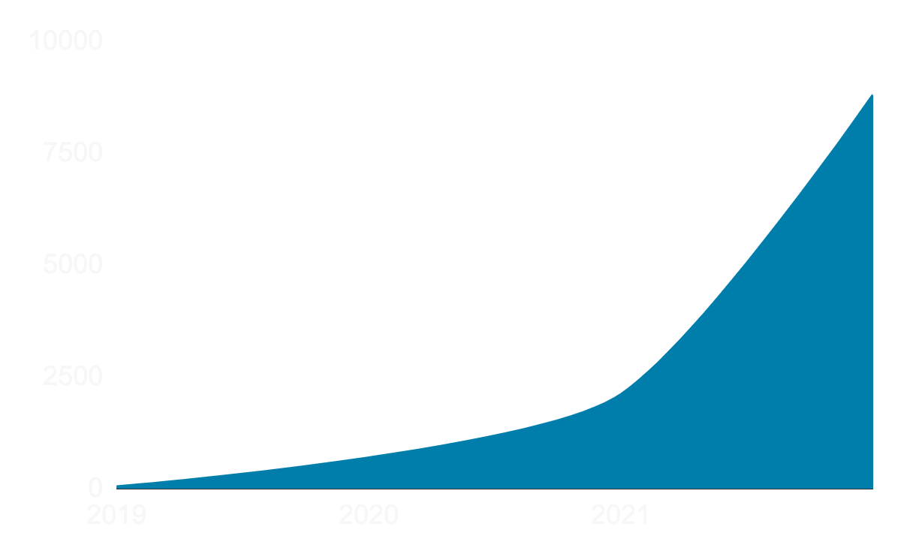
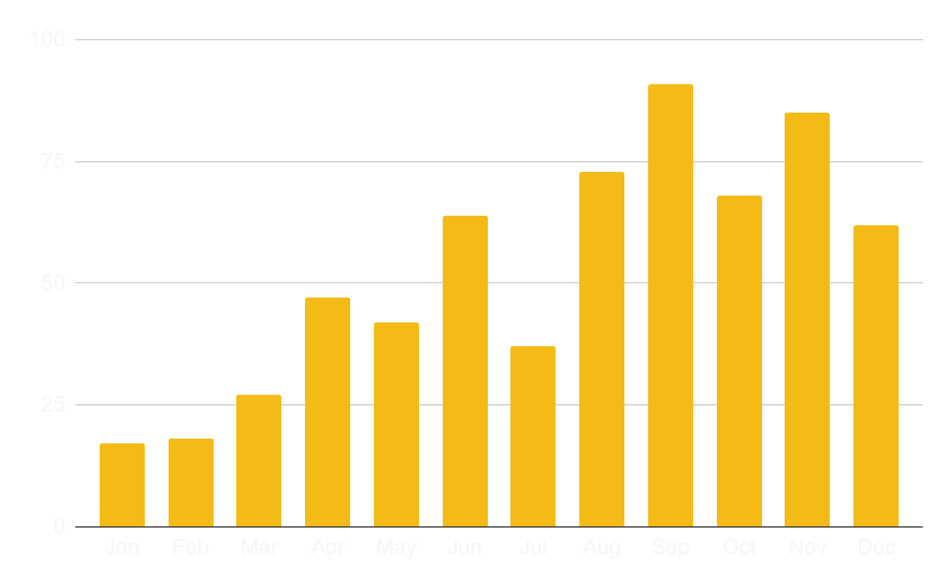
Growth of FinOps Industry
Social proof of those offering or seeking skills
Linkedin (People - FinOps)
Posts in #jobs in the Slack 2021

Slide 6
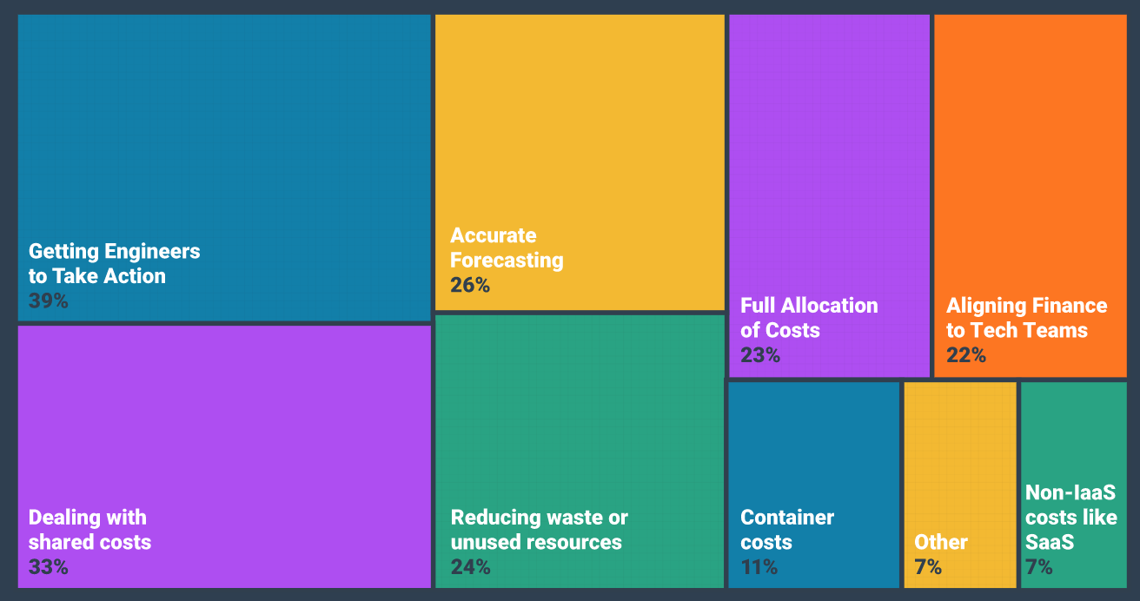
Data.FinOps.Org: what are your top challenges?
Use of this work requires attribution to the FinOps Foundation under the ccby4.0 license
Notes:
Getting engineers to take action on cost optimization” is the clear winner here-- it’s a challenge all FinOps teams seem to face. Other big challenges include allocating shared and unallocated costs, forecasting variable spend, aligning tech and finance teams, reporting on container costs, and reducing waste.

Slide 7


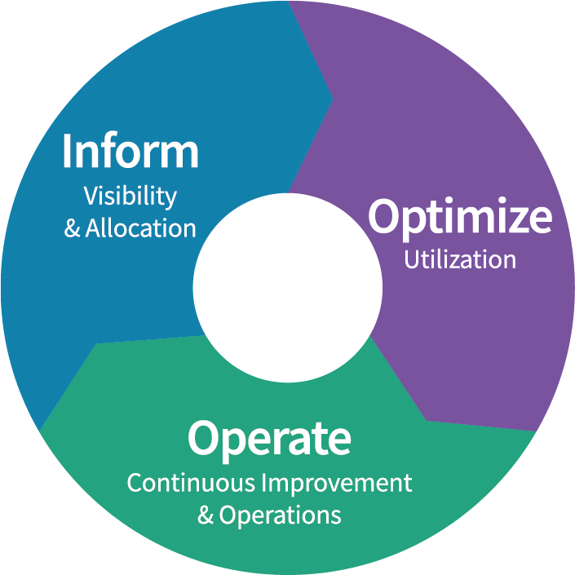





FinOps
Framework
FinOps is an evolving cloud financial management discipline and cultural practice that enables organizations to get maximum business value by helping engineering, finance & business teams to collaborate on data-driven spending decision
Maturity
Crawl
Walk
Run
Principles
Personas
Phases
Teams need to collaborate
Everyone takes ownership for their cloud usage
A centralized team drives FinOps
Reports should be accessible and timely
Decisions are driven by business value of cloud
Take advantage of the variable cost model of the cloud
FinOps Practitioner
Executive
Rates
& Usage
Business/Product Owner
Finance/Procurement
Engineering/Operations
Domains
Understanding Cloud Usage and Cost
Performance Tracking & Benchmarking
Real-Time Decision Making
Cloud Rate Optimization
Cloud Usage Optimization
Organizational Alignment
Notes:
The FinOps Framework describes the
Principles that drive our FinOps practices
The Personas that FinOps must support as stakeholders
The best practices and process models that allow us to accomplish this
And the Domains of activity we will have to perform in our FinOps practice
You May have heard the Framework called the FinOps Capability Model, or the FinOps Function model previously.
Updated beginning in Fall 2021, will continue to be modified as time goes on, but is largely stable as of January 2022.
FinOps practitioners will perform activities in each of these domains as they build a FinOps team and drive the cultural change that FinOps brings into their organizations.
There are Capabilities within each Domain that describe the detailed activities that a

Slide 8



FinOps Foundation Mission
To advance the people who do cloud financial management through community, education, and standards.
Create Community through events, meetups, slack and other channels
Advance Careers through talent development, training and certification
Define Standards through open source collaboration, working groups and SIGs

Slide 9
Addendum

Slide 10
We are a Linux Foundation Program
Practitioner Community
Governing Board
Technical Advisory Council
Marketing Committee
End User
SIGs and
User Groups
Special Interest Groups
Fund and manage the budget
Marketing and strategic direction
Elected & premier members
Real world practitioners
Connect and grow community
Share learnings and stories
10 top FinOps experts
Defines standards
Elected individuals
Notes:
Modernization of Finance applications

Slide 11




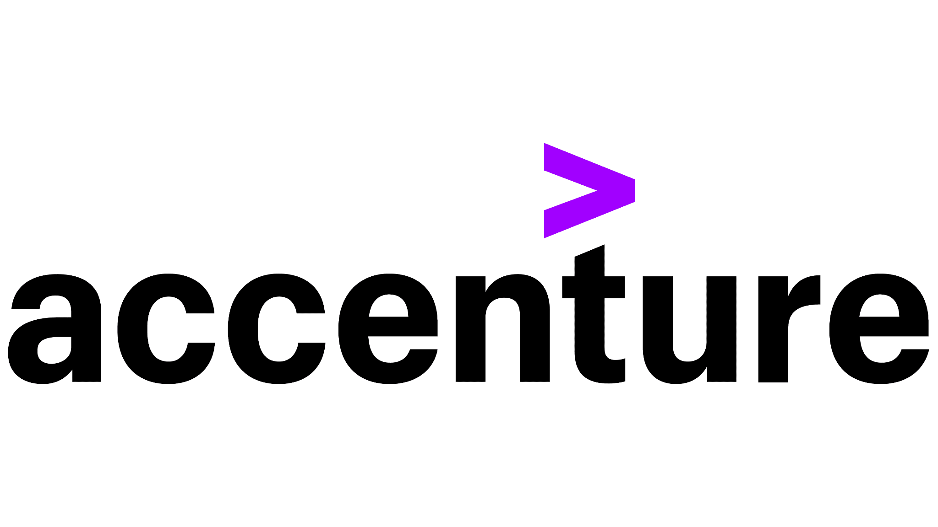












5600
1800
PREMIER PARTNERS
MEMBERS
CERTIFIED PRACTITIONERS
Notes:
Add Certifications to this

Slide 12





















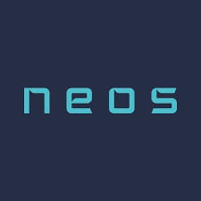













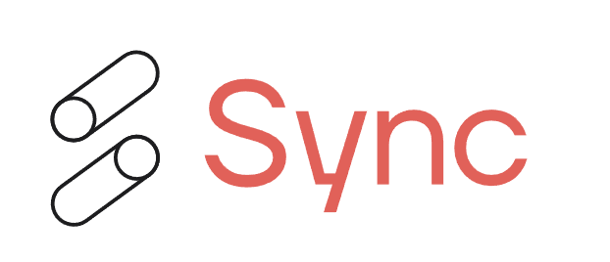





5600
1800
PREMIER PARTNERS
MEMBERS
CERTIFIED PRACTITIONERS
Notes:
Add Certifications to this

Slide 13
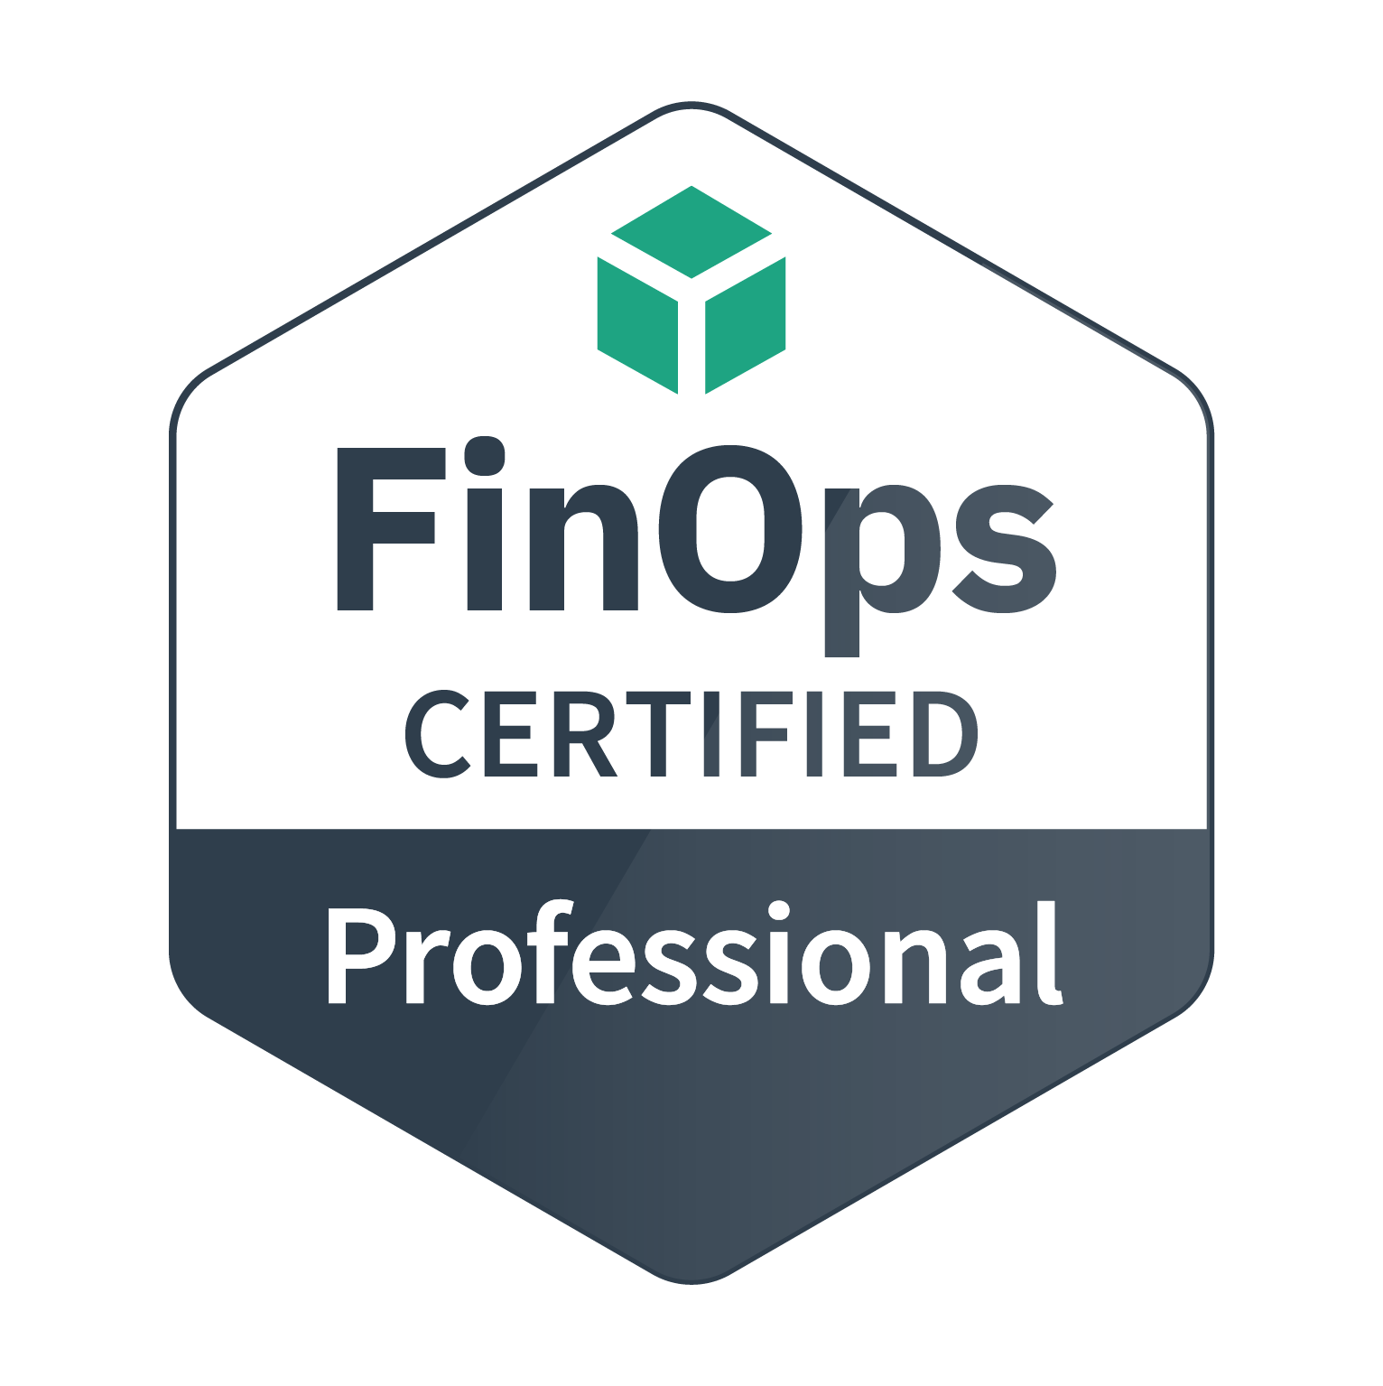
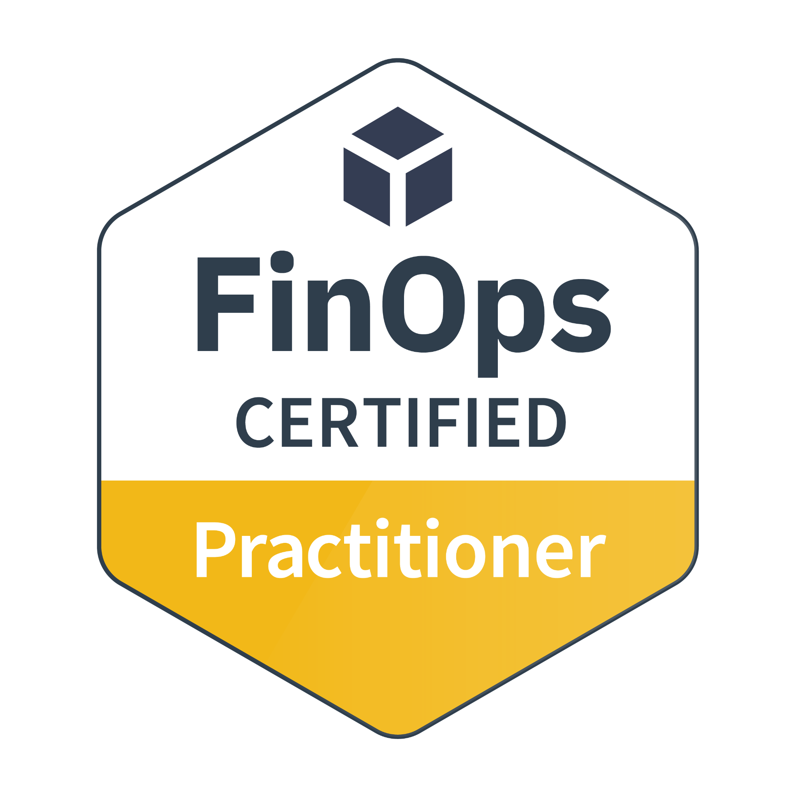
Training and Certification
Certification Track for FinOps practitioners and consultants
FinOps Certified Practitioner
FinOps Certified Professional
Persona-based Training for stakeholders working with FinOps teams
Individual courses for Engineers, Finance, Executives, Procurement and Product
Go to FinOps.org/certification
77% share on LinkedIn* *Source: October 2021 Credly.com Badge Share Data
Notes:
Our funding comes from two primary sources: 1) is Training/Certification.
There’s the FOCP now and also FOFE. FOFA is in development as well as persona based trainings for Finance/Execs/etc.

Slide 14
FinOpsverse
Slack
Community
Summits
FinOps.org
Framework
Training
& Certification
Vendor
Certification
Working
Groups
State of
FinOps
Regional
Meetups
Notes:
Importance by Size, Color by Status, Practitioner could be green (1500-4000 this year but want to accelerate).
Cert: need to get more of community certified, drive more through our lists, and leverage more of LF's massive 10 figure training business
Standards: metrics aren’t set.
Vendor members doing well.

Slide 15
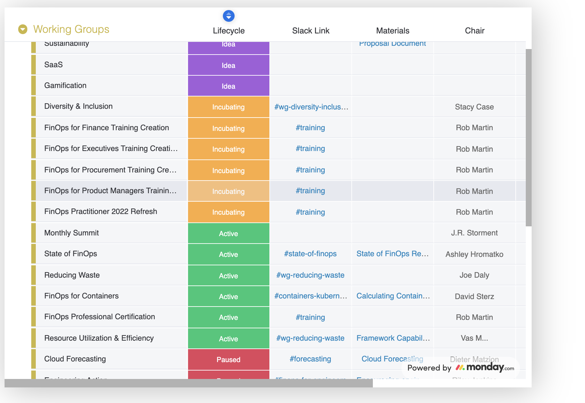
Contribute to Working Groups
Practitioner Working Groups (WG) create best practices and standards, supported by vendor members.
Special Interest Groups (SIG) create community and benchmarking.
These feed into the FinOps Framework and output Projects.
See Current Groups

Slide 16
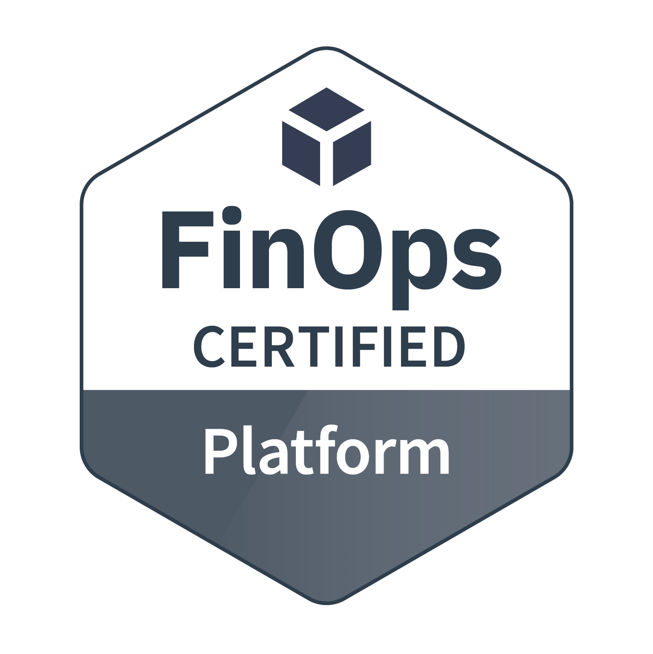
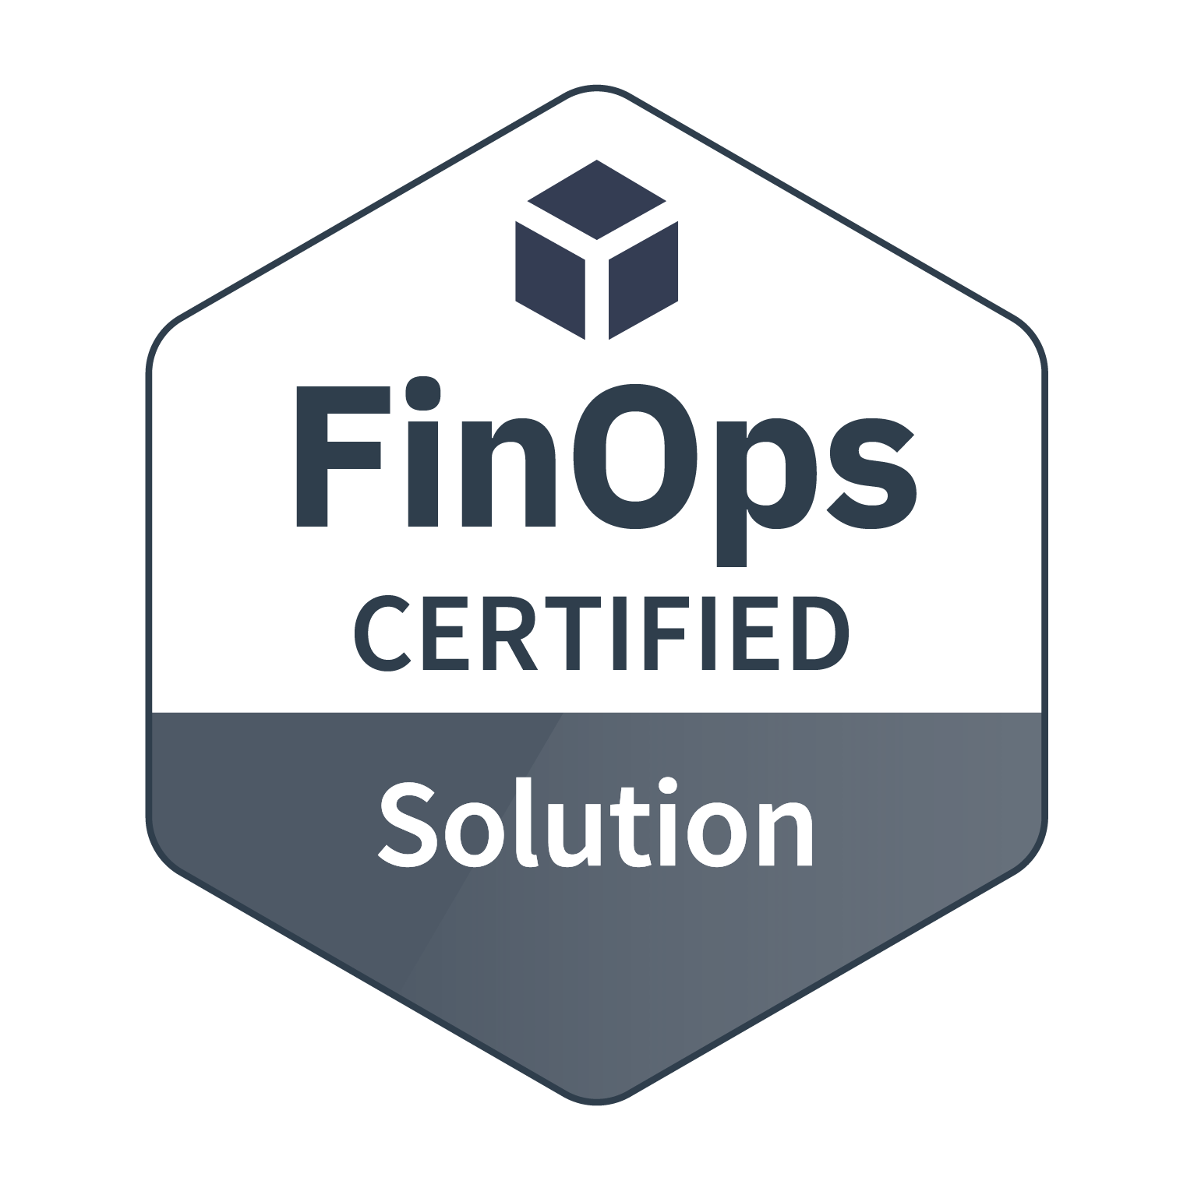
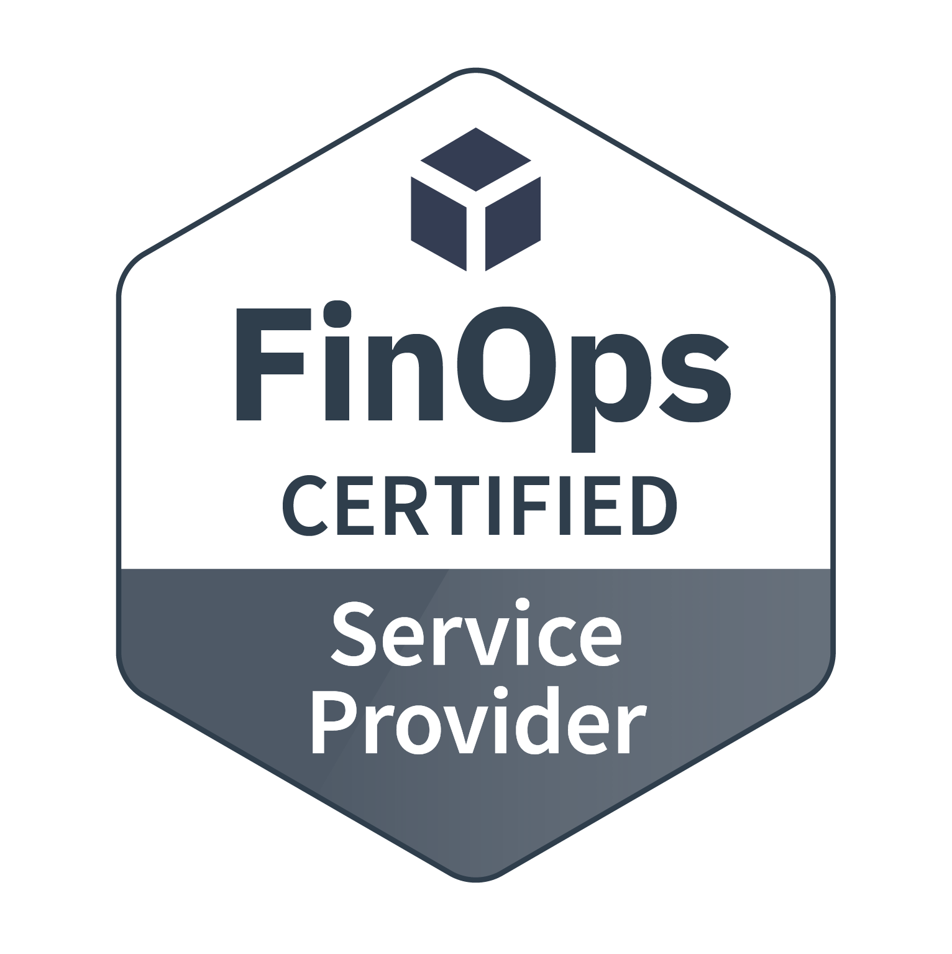
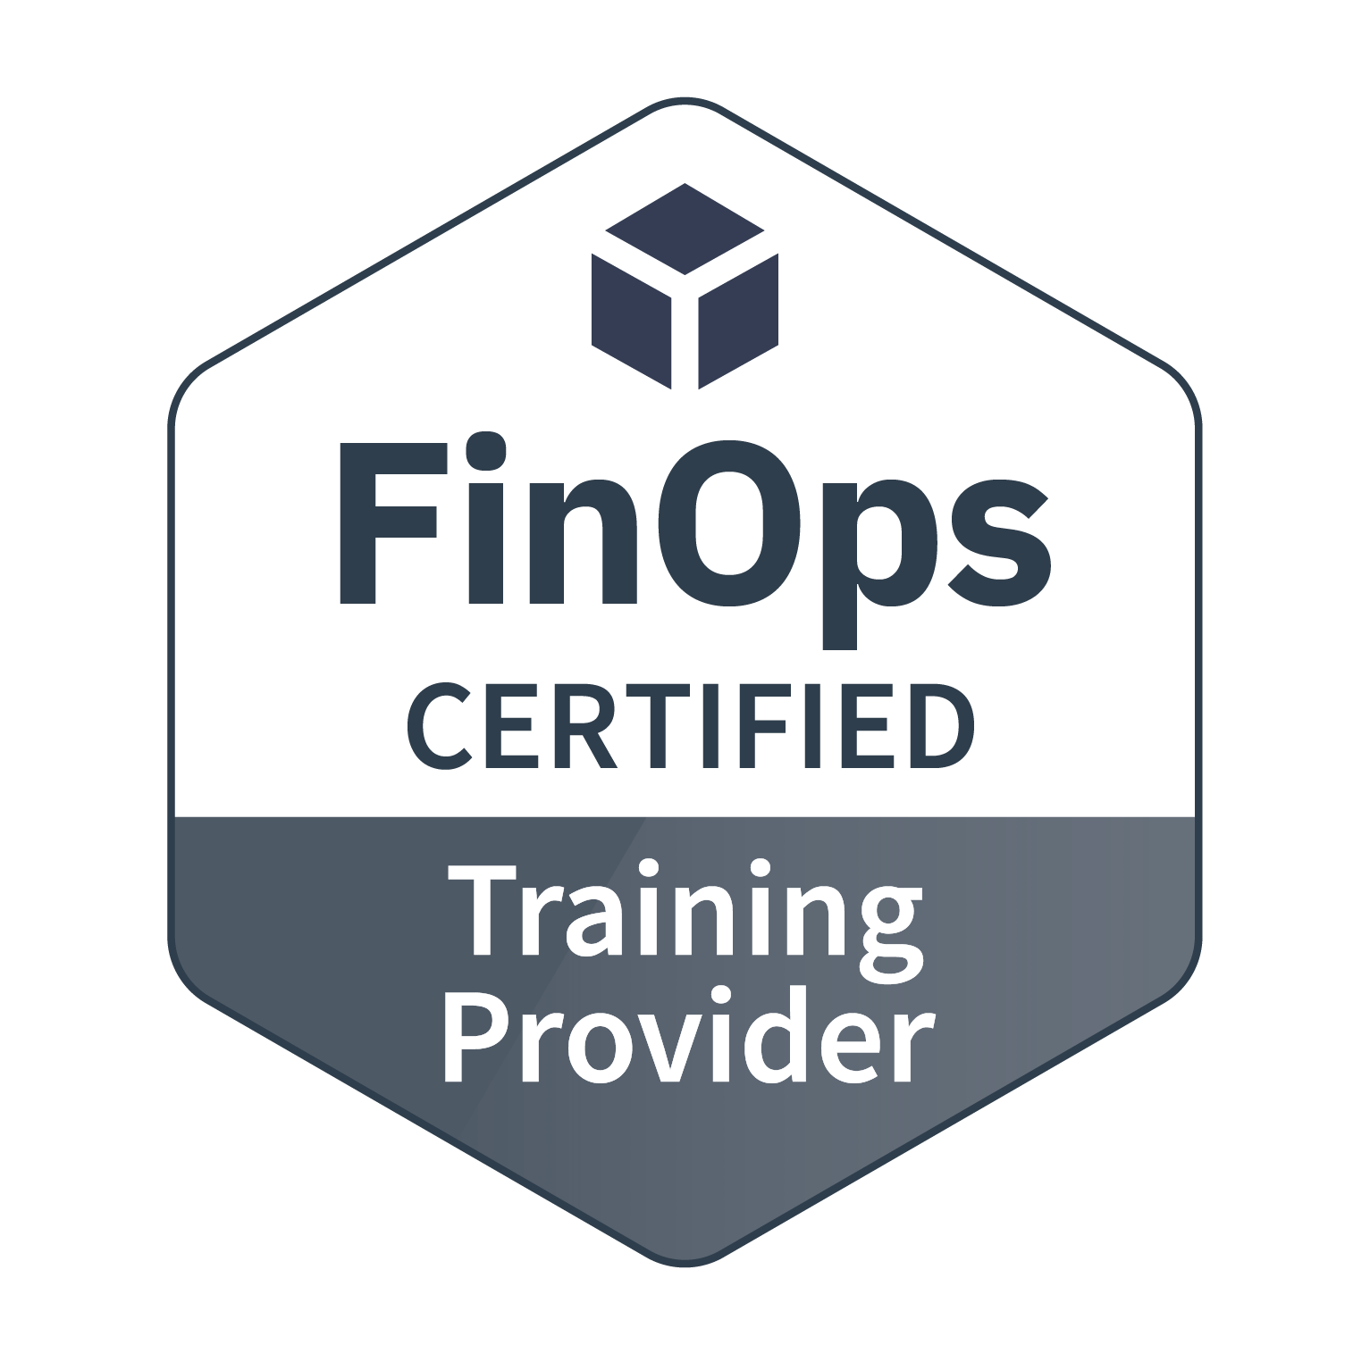
Vendor Certifications
Technology providers that license and deliver a software product to help people successfully adopt cloud financial management practices aligned with the FinOps standards.
Providers that deliver solutions that contain a subset of the functionality found in the Certified Platforms which solve a specific part of a cloud cost management challenge.
FinOps experienced professional service providers that consult with enterprises about cloud financial management and help their clients with best practices.
Vetted training providers who have deep experience in cloud financial management training.
View details and requirements

